Slide 1
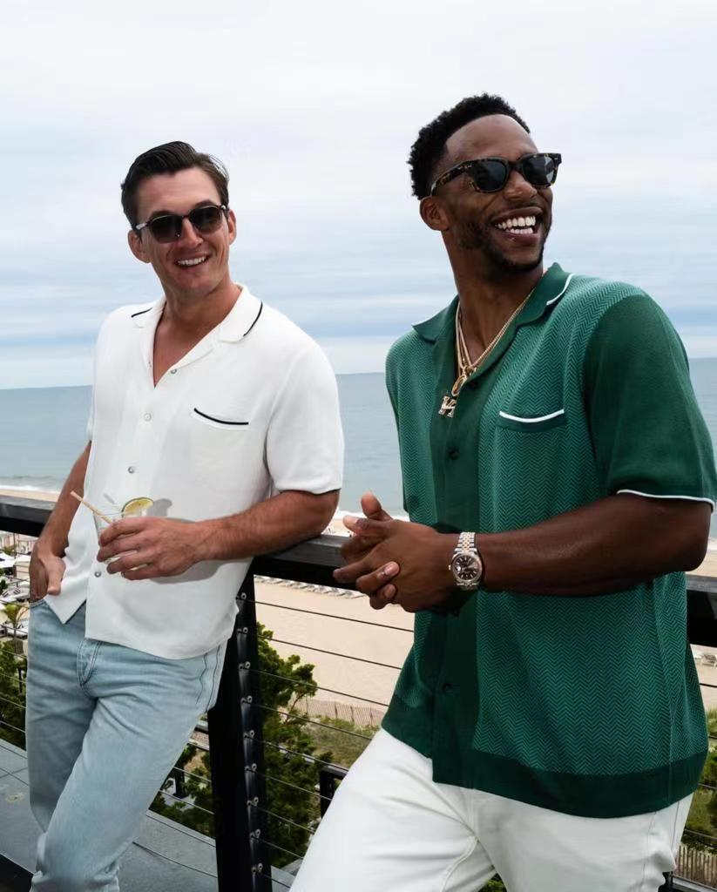

Bonsai Company Ltd
We made your ideas come true …

Slide 2
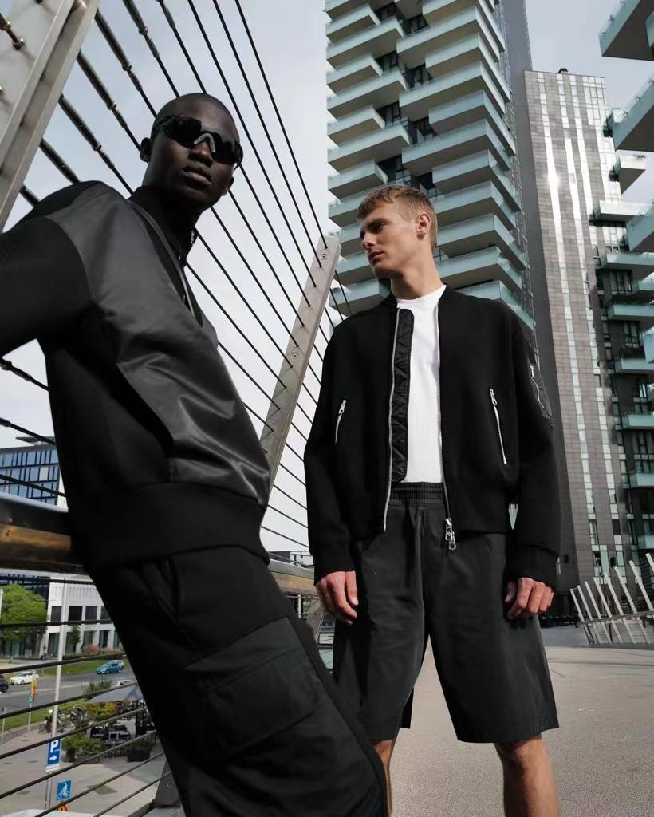
Company Introduction
Bonsai Company Limited is a family-based knitwear manufacturer company established in
Hong Kong since 2011, mother company Rainbowtex fashion knits Ltd is the mother company established since 1988. We re-located our factory to located in the south east of China in 1993, with a variety of knitting gauges and highly skilled staffs.
We produce high quality men’s, women’s, children’s and accessories knitwear using natural fibres combining traditional methods and modern technology.
The majority of our product is made using the highest quality yarns from premium local and European spinners.
We specialize in knitting Italian Extra Fine Merino which is treated with a Total
Easy care finish making it long lasting but retaining the soft lustre of the fibre.
We also product Viscose blends with print to the highest quality which we treat in our own printing factory to be machine washable for long lasting performance.

Slide 3
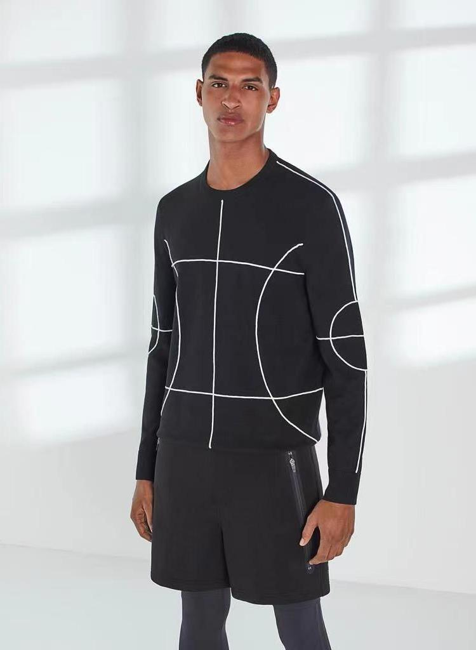
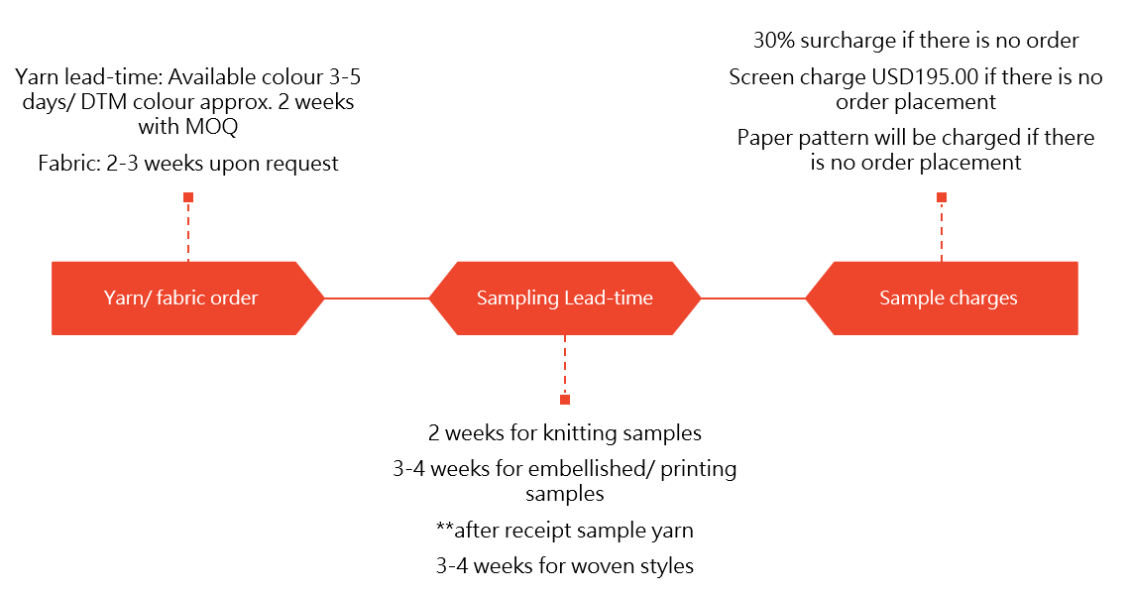
Product Development
We have a large showroom for our customers and designers to use when they visit our facility in China.
Each of our customers has the opportunity to develop their own designs, specifications and make yarn and colour selections from the wide range of spinners that we work with.

Slide 4
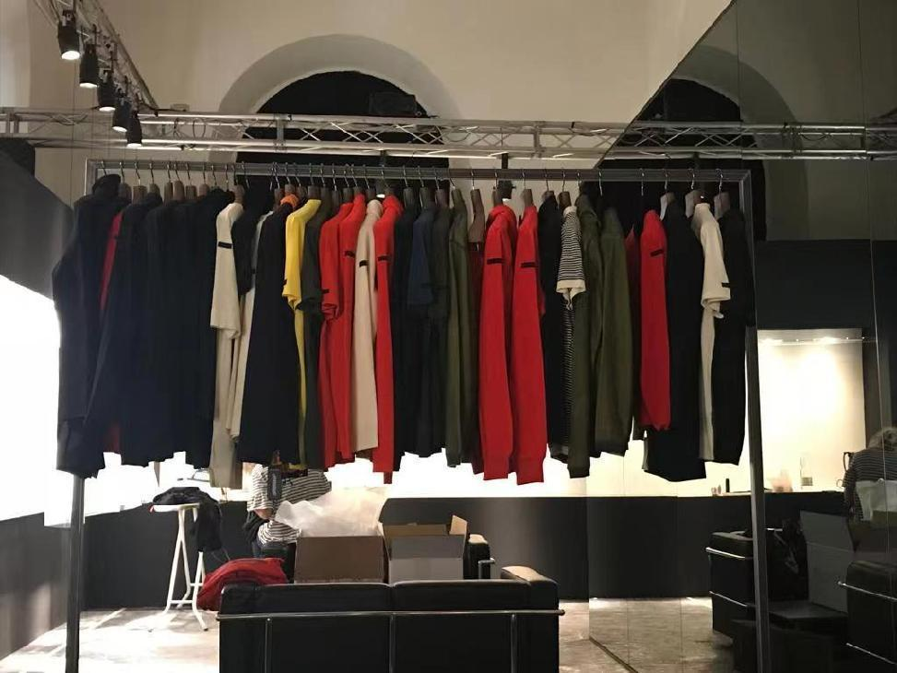
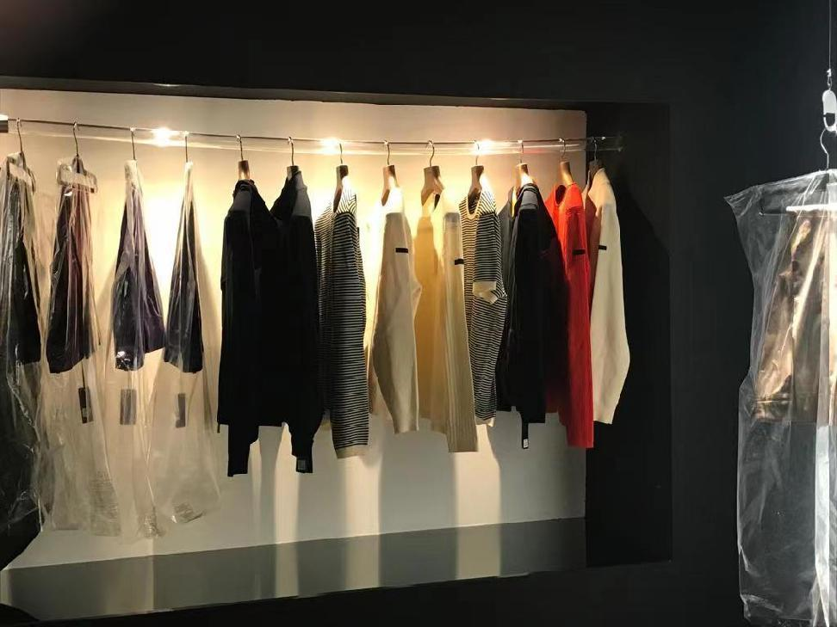
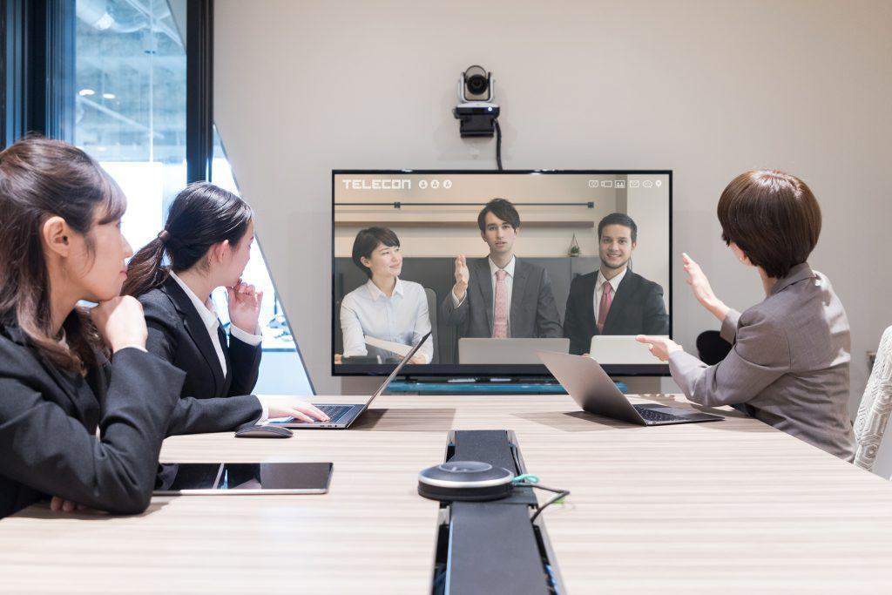
To eliminated the challenge we faced during Covid-pandemic, we can have zoom meeting or team video conference with customers’ preferred schedule.
This can be booked upon requested.

Slide 5
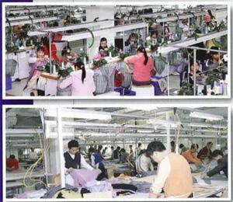
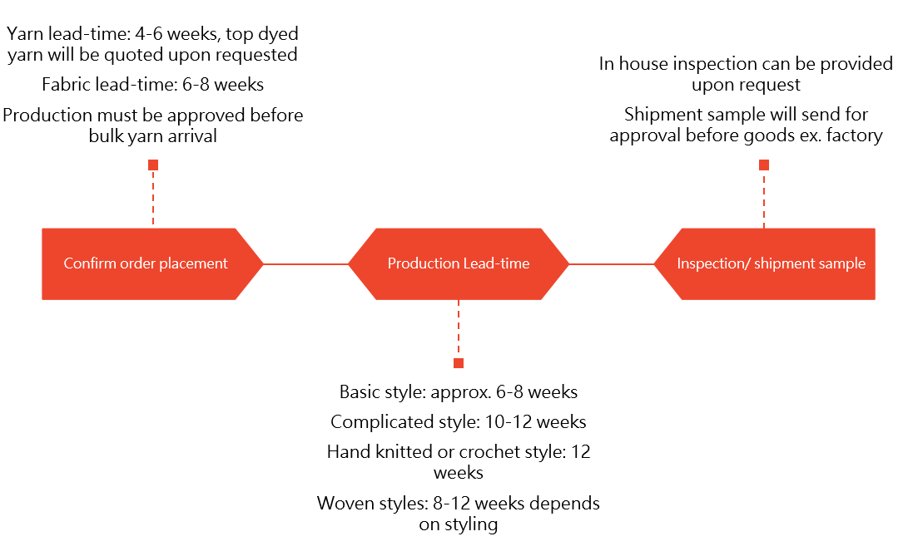
Production flowchart & lead-time
Our production facility can operate with much smaller order for maximum flexibility and shorter lead time.

Slide 6
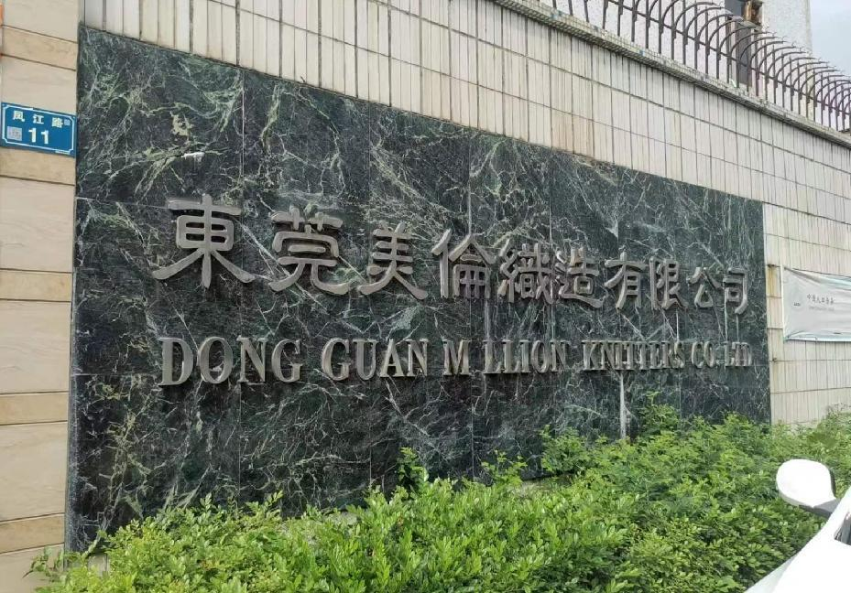
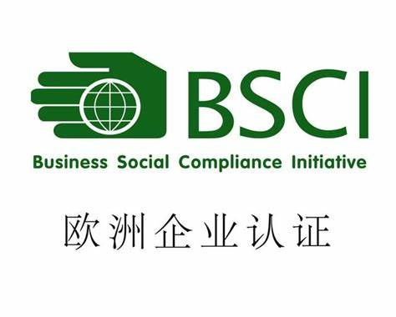
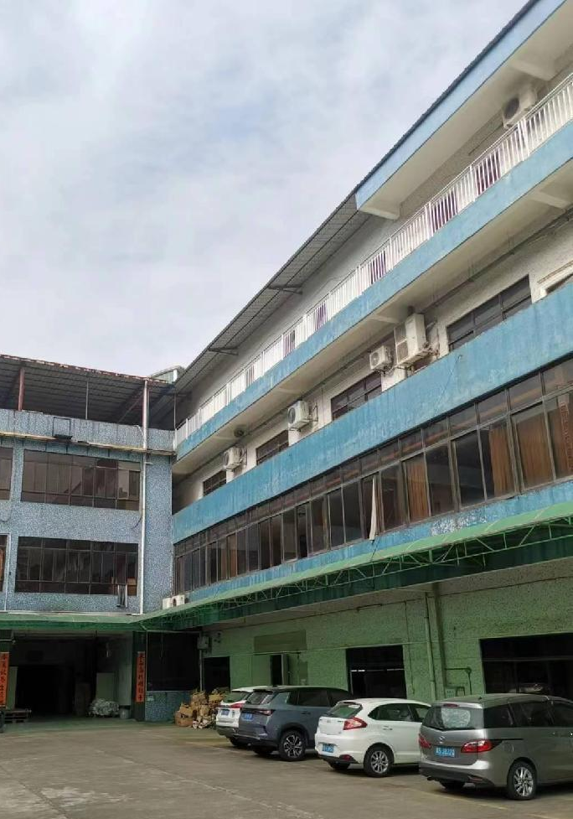
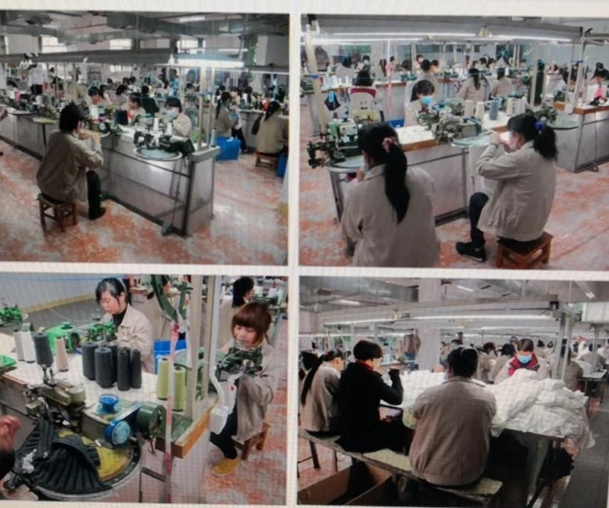
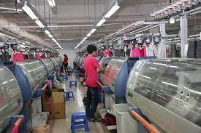
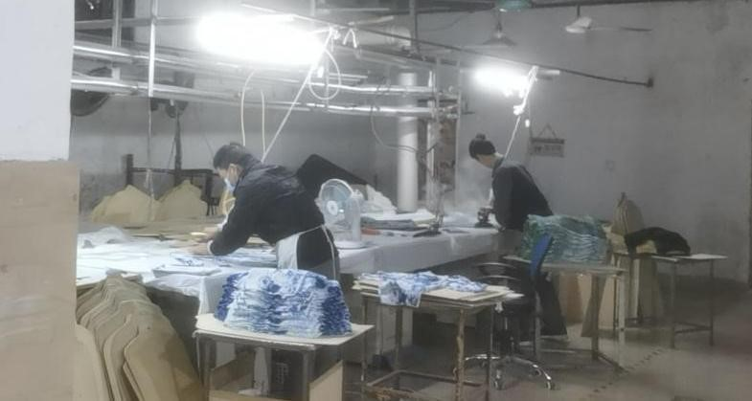
Knitting Factory Profile:
Dongguan Million Knitters Co., LTD
Site amfori ID : 156-043906-001
Address : No. 11 Feng Jiang Road, Chang Ping Town
523-565, Dong Guan Guangdong Sheng China
MOQ: 300pcs (avg: 600 too 1200pcs per order)
Factory size: 7000 SQ M2
No. of Workers: 130 workers
Capacity: 30000 per month
The range of our garment products included Men’s and
Ladies’ knitted fully fashioned garments.
e.g.: Pullovers, Cardigans, Dresses, Skirts, Pants, Scarf, Hats, Gloves, Printed garments
Handknitted, 3, 5, 7, 9, 12, 14, 16 & 18GG

Slide 7
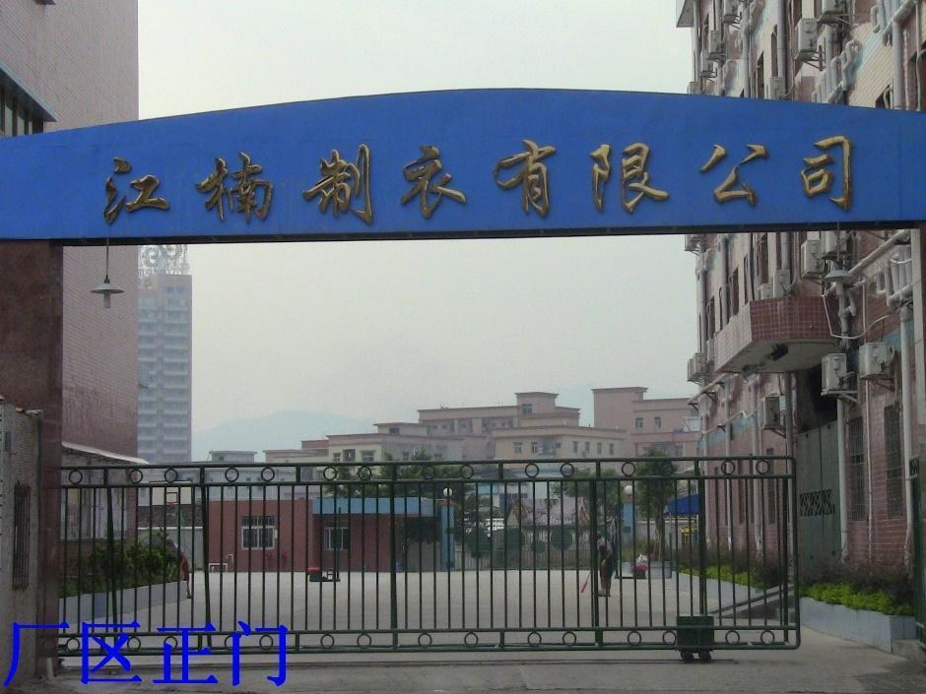
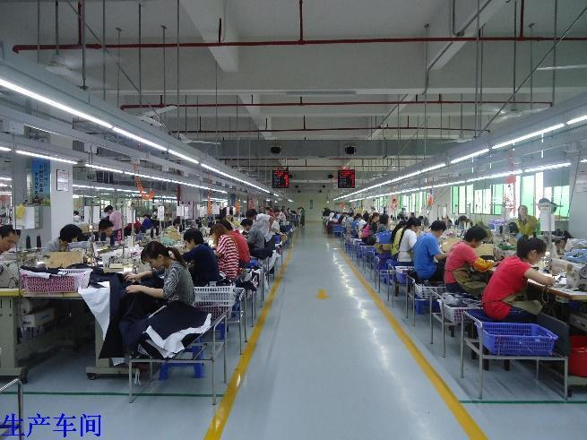
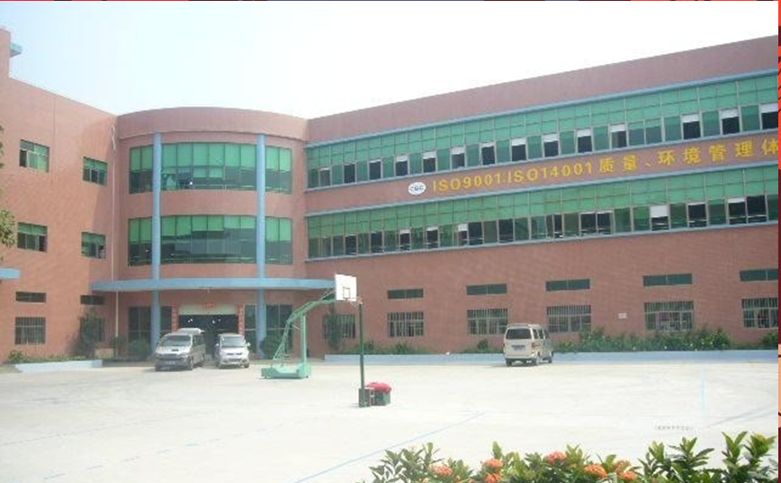
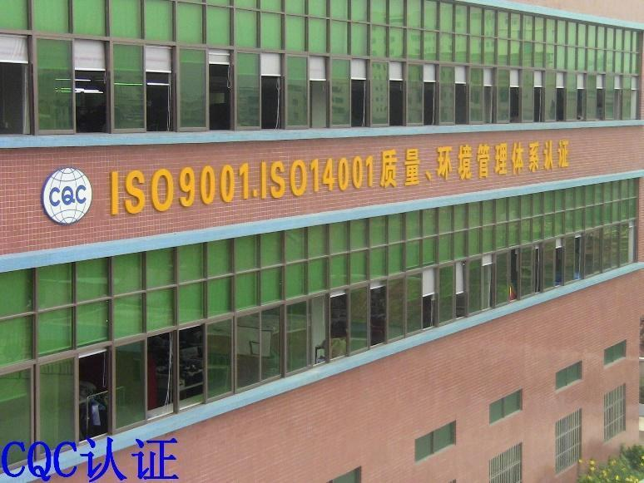
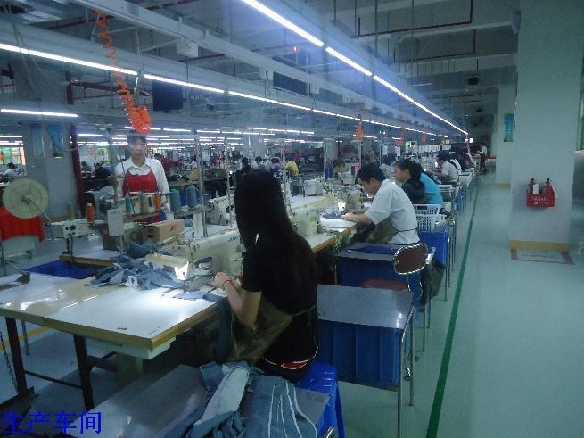
Woven Factory Profile (Partnership cooperation):
Jiangnan Clothing Company Ltd. (Dong Guan)
MOQ: 300pcs (avg: 600 too 3000pcs per order)
Factory size:
No. of Workers: 200 workers
Capacity: at least 60000 per month (from March to Dec)
The range of our garment products included Men’s and
Ladies’ knitted cut & sewn garments.
e.g.: Blazer, Jackets, Sweatshirts, Washed garments, Ladies’ blouses, Dresses, Skirt, Pants etc.

Slide 8
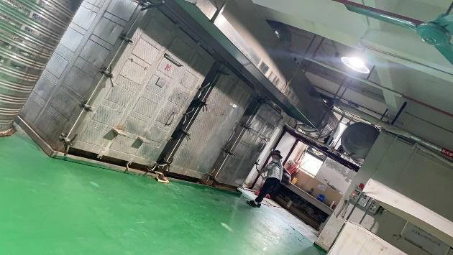
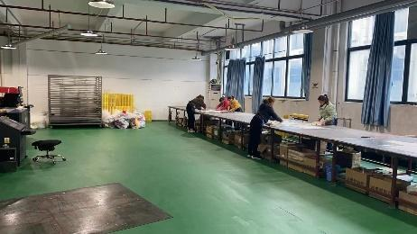
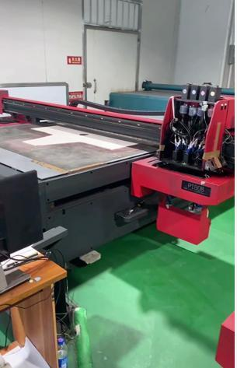
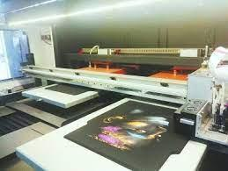
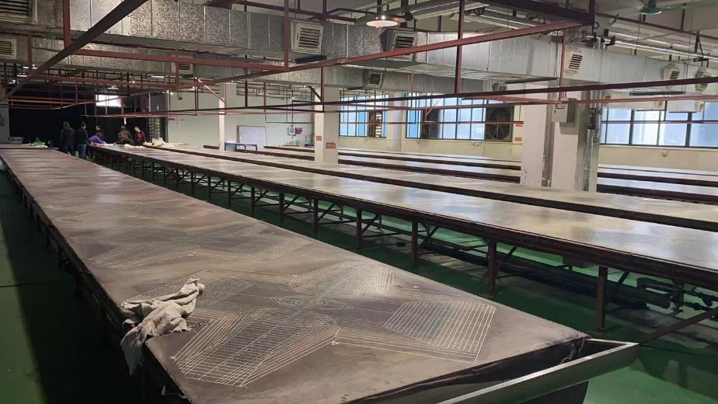
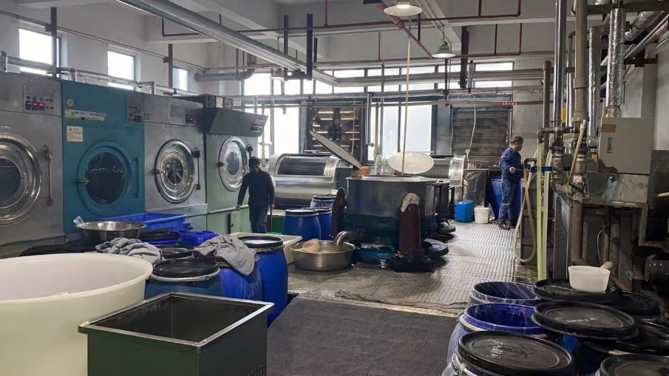
Printing Capacity:
MOQ: 1000pcs per day (digital print), 1500pcs per day (screen print)
Factory size: 5000 SQ M2
No. of Workers: 100 workers
Capacity: 20000 – 50000 per month (from March to Dec)
The range of our garment products included Men’s and
Ladies’ knitted printed garments/ panels.
Digital printing, acid wash, pigment print, screen printing, rubber printing etc….

Slide 9
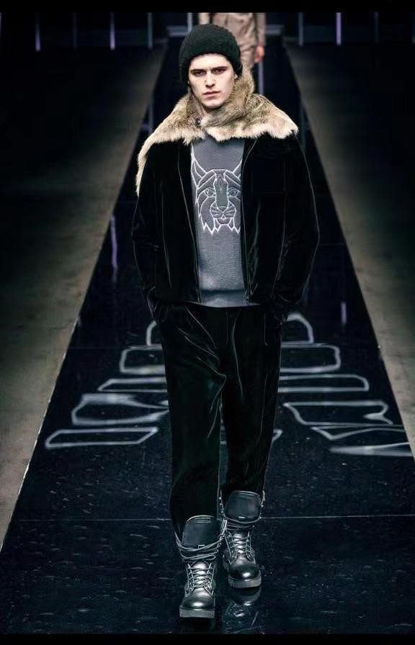
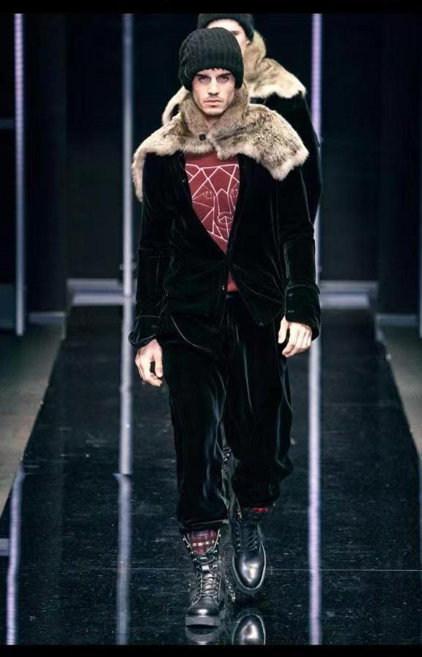
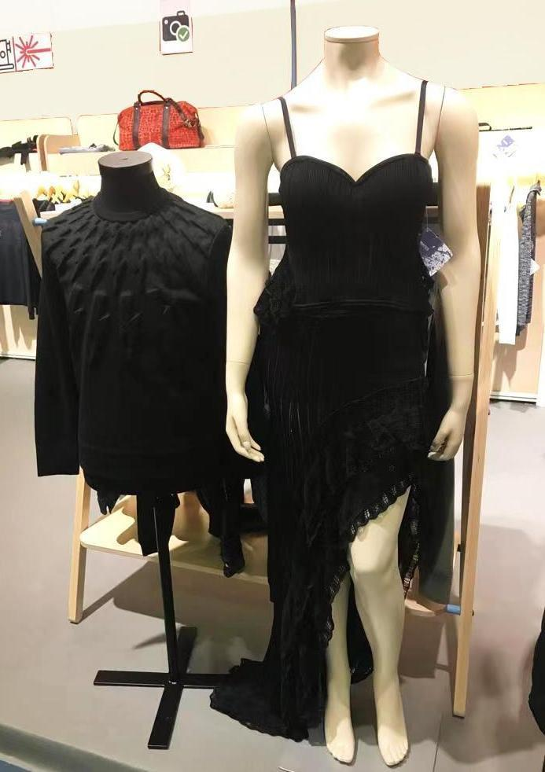
Part of style display

Slide 10

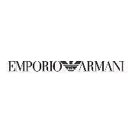
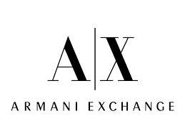
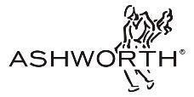
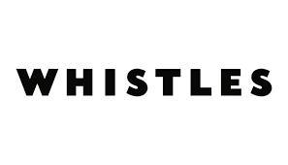
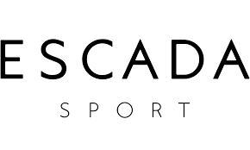


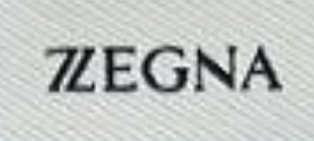


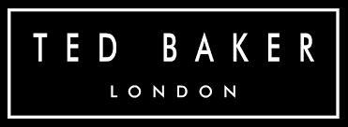

We acknowledge that there is an increasing awareness about human rights of workers in the society and therefore more brands and buyers are looking for factories with high standard of social conduct. Our factory has passed the audit from BSCI (Business Social Compliance Initiative, the international standard for social conduct) since 2008.
 | BUYING OFFICE | BUYERS & LABELS
1 | HUGO BOSS | HUGO, BOSS ORANGE, BOSS GREEN, BOSS MEN & WOMEN | over 18 years
2 | ESCADA GROUP | ESCADA ML, ESCADA SPORT | over 13 years
3 | HAUBER GROUP | LUISA CERANO, HAUBER | over 17 years
4 | MARC O' POLO | MARC O' POLO | over 6 years
5 | PUMA | UM, Alexandra McQueen. | over 5 years
6 | LACOSTE | Live, Sportswear, Sport | over 10 years
7 | IC GROUP | Tiger of Sweden, BMB | 2 years
8 | YGM | ASHWORTH | 4 years
9 | TriStyle Sourcing Ltd. | Madeleine | 3 years
10 | Vmade Official Ltd. | Vindustries | 3 years

Slide 11
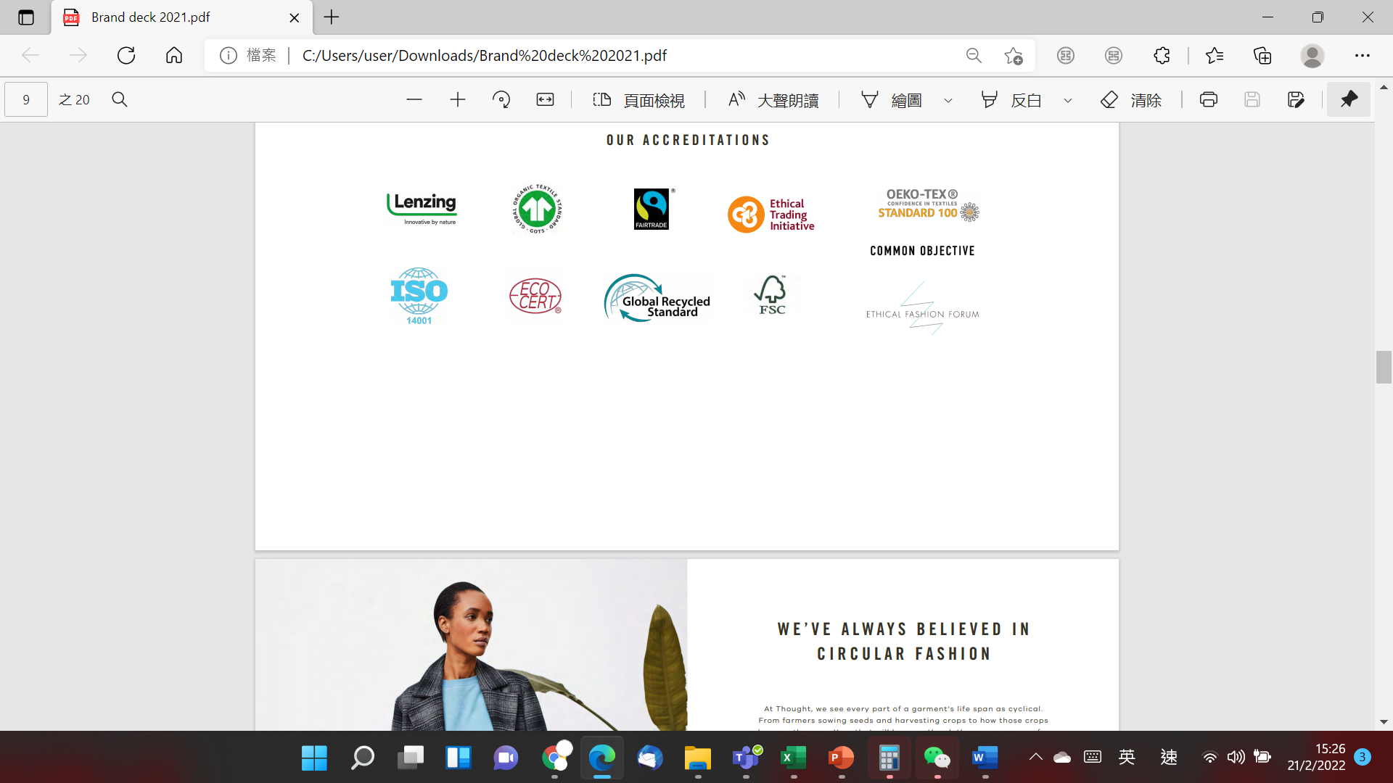
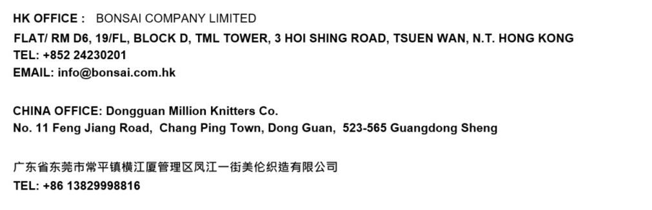
We SUPPORT reduce pollution and environomental friendly, we started using lenzing viscose, FSC viscose and different kind of sustainable qualities since few years ago. Our working partners included:
Contact us

